Slide 1
STORAGE OPTIMIZATION, SERVICE UPGRADE
TIMIPIRI GODGIFT / APRIL 11 2024.

Slide 2
PROBLEMS
DELAYED PRODUCT SHIPPING
DISORGANIZED STORAGE
HIGH INVENTORY

Slide 3
Processes involved
Create database “MintClassics using MySQL Workbench.
Load data from SQL file to create and populate tables
Identify relevant tables for analysis (Products, Orders, Warehouses, OrderDetails).
Used SQL queries that includes table joins to perform analysis.

Slide 4
KEY FINDINGS
Products are shipped between 48 to 1560 hours
High inventory
Low sales
Inefficient storage
Poor communication among key departments
Lack of automated inventory monitory systems

Slide 5
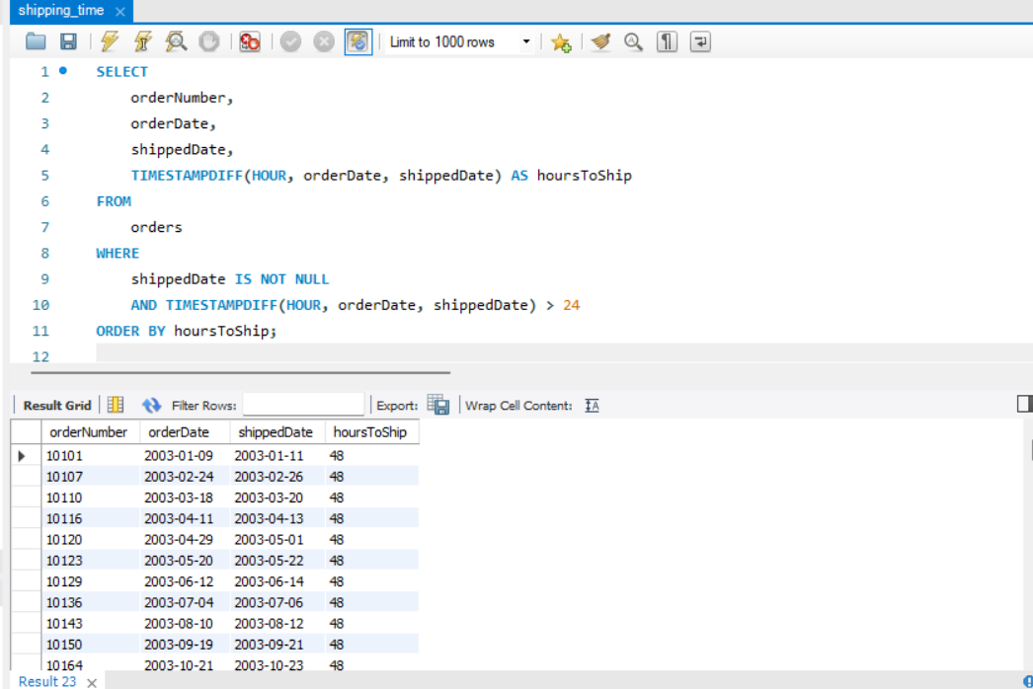
Sample output of shipping time (fastest)

Slide 6
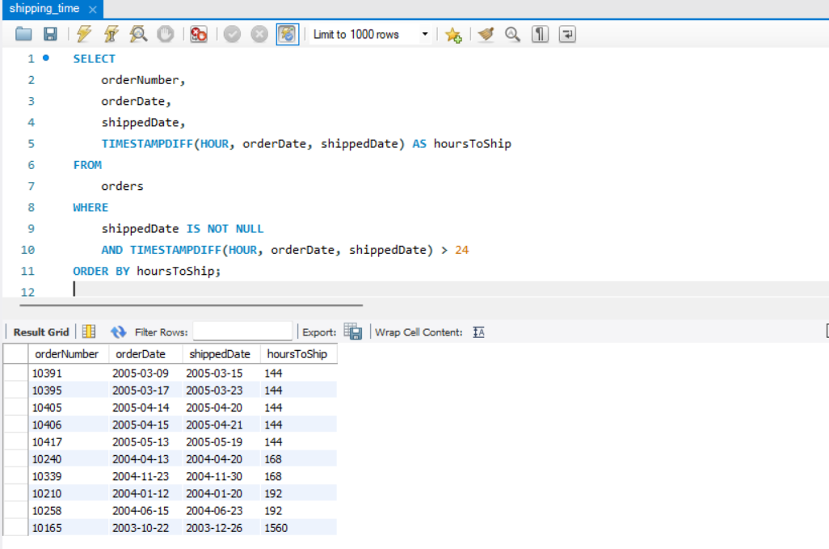
Sample output of shipping time (slowest)

Slide 7
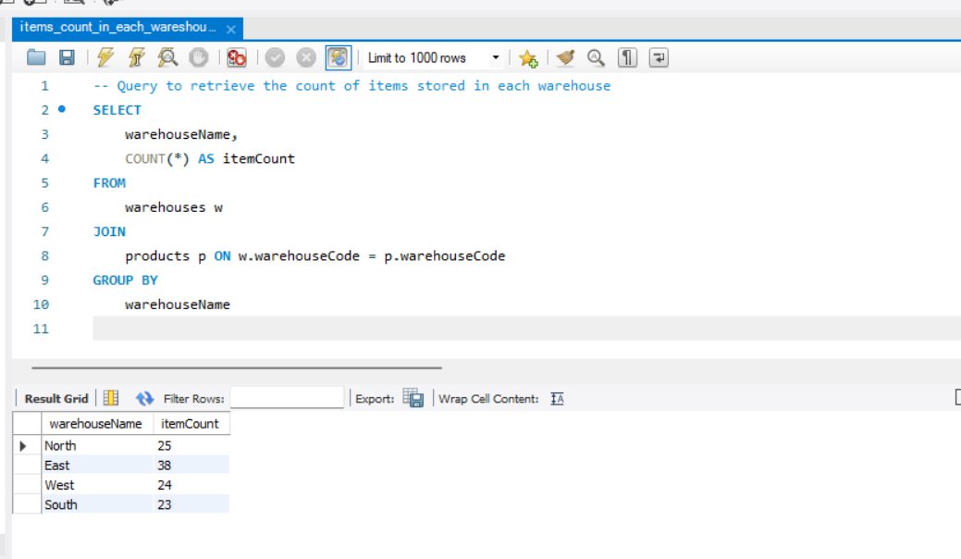
Count of items in each warehouse

Slide 8
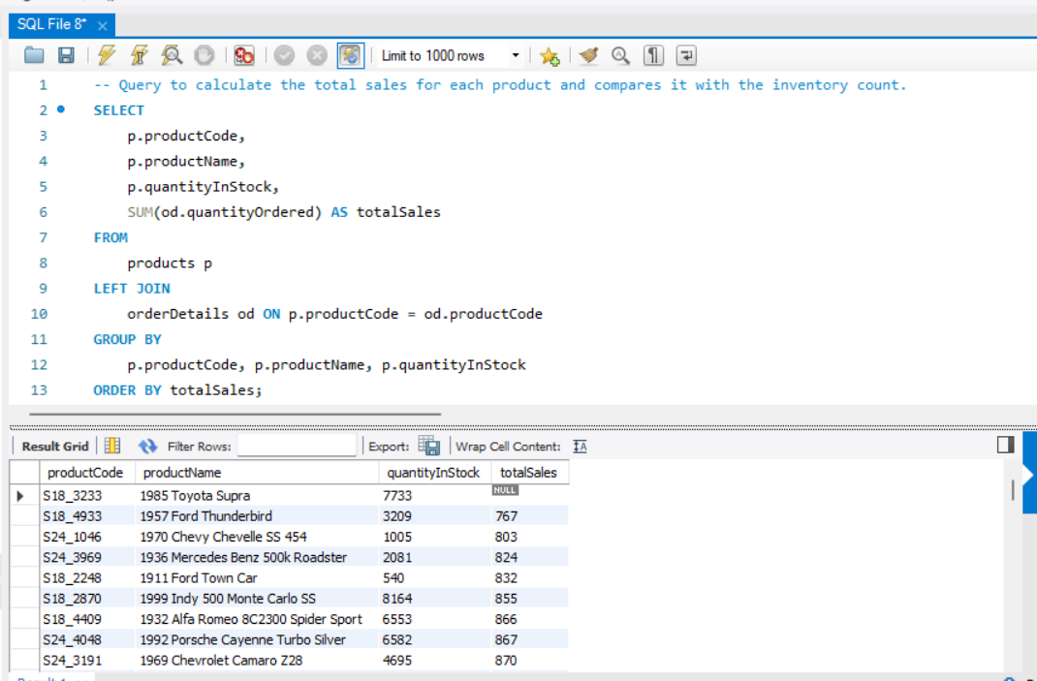
Total sales of each item compared to total inventory

Slide 9
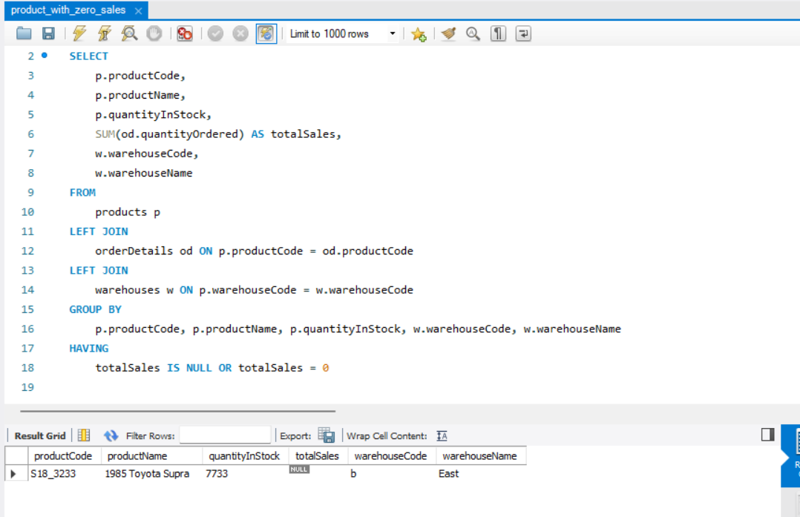
Product with zero sales

Slide 10
RCOMMENDATIONS
Improve communication among key departments like sales, warehouse, shipping and customer service.
Implement real-time inventory tracking and systems. This should reduce over-stocking.
Implement efficient storage systems and workflows to reduce the time it takes to locate and retrieve items for shipping

Slide 11
MORE RECOMMENDATIONS
Evaluate a product’s relevance to the target market, and prepare to phase them out should they become irrelevant.
Product promotion and visibility. Display products visibly on company’s website and consider running promotions, discounts to drive sales.
Seek feedback from your customers to know their preferences, concerns and reasons for not liking a particular product.

Slide 12
THANK YOU

Slide 13
FOR QUESTIONS AND CLARIFICATION
EMAIL: timipiri.godgift@gmail.com
Mobile: +2348037561042

